Slide 1

"Optimizing Healthcare Order Analytics with My SQL"

Slide 2
AGENDA OF PROJECT
INTRODUCTION
AIM OF THE PROJECT
QUERIES
INSIGHTS
RECOMMENDATIONS
CONCLUSION

Slide 3
INTRODUCTION
OVERVIEW : This project focuses on analyzing e-commerce order data to gain insights into customer behaviors, spending habits, and order management. The SQL queries explore various aspects such as the total amount spent by customers in different cities, average order values in different states, and the comparison between COD and non-COD orders.
OBJECTIVE : The objective of this project is to analyze e-commerce order data to understand customer purchasing behaviors, payment preferences, and regional trends.
DATA SOURCE : The data source represents transactional details from an e-commerce platform. It contains information about customer orders, including order IDs, customer names, cities, states, addresses, payment methods, order statuses, and product details.

Slide 4

TOOLS USED
MySQL Workbench is a tool that helps you work with MySQL databases easily. It provides a user-friendly interface to create, manage, and analyze databases without needing to type commands all the time.

Slide 5
Where did you get the data from ?
Got it from open source

Slide 6

Aim of The Project :
In the ever-evolving healthcare industry, efficient order management plays a crucial role in ensuring timely delivery of medical supplies, accurate billing, and enhanced patient care. This project, "Optimizing Healthcare Order Analytics with SQL," leverages the power of SQL to analyze, manage, and derive meaningful insights from healthcare order data . The project explores a range of analytical scenarios such as tracking total orders, evaluating spending patterns across different regions, understanding payment methods (COD vs. non-COD), and identifying trends in order placement and fulfillment.

Slide 7

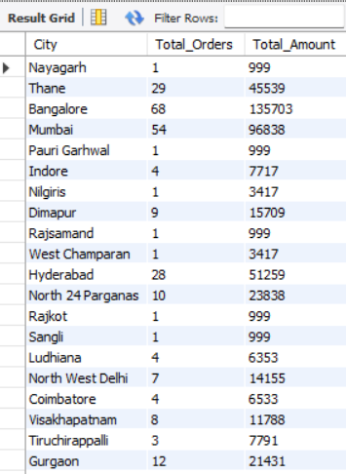
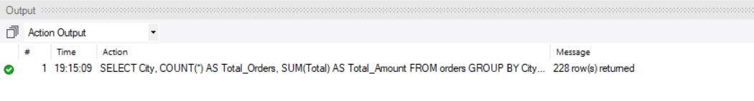
Total Number of Orders and Amount Spent for Each City :
SELECT City, COUNT(*) AS Total_Orders , SUM(Total) As Total_Amount
FROM orders
GROUP BY City;

Slide 8

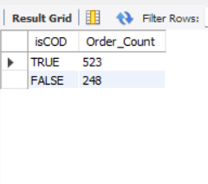
Count of Orders with isCOD True and False: SELECT isCOD, COUNT(*) AS Order_Count FROM orders GROUP BY isCOD;

Slide 9

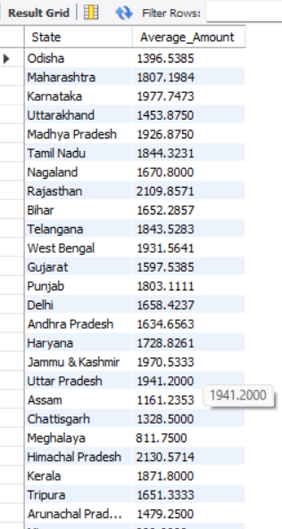
Average Order Amount for Each State. SELECT State, AVG(Total) AS Average_Amount FROM orders GROUP BY State;

Slide 10

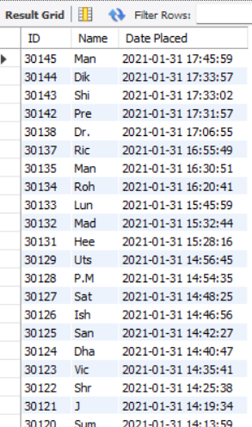
List all orders placed after January 31, 2021, from the orders table.
SELECT ID, Name, `Date Placed` FROM `orderscleaned (2)`
WHERE `Date Placed` > '2021-01-31';

Slide 11

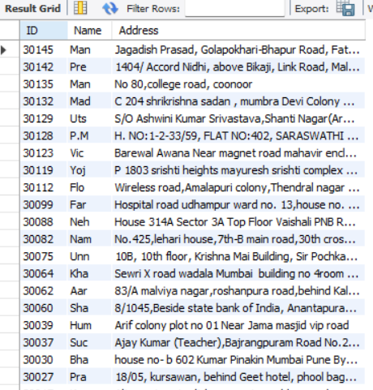
Show all orders where the Address contains the word "Road" from the orders table.
SELECT ID, Name, Address FROM `orderscleaned (2)`
WHERE Address LIKE '%Road%';

Slide 12

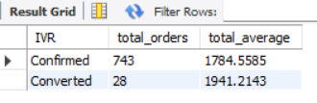
Calculate the total number of orders and the average total amount for each IVR type.
SELECT IVR, count(*) as total_orders , avg(total) as total_average
FROM orders
GROUP BY IVR;

Slide 13

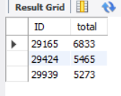
Find the top 3 highest total amounts.
SELECT ID , total FROM orders ORDER BY total DESC limit 3;

Slide 14
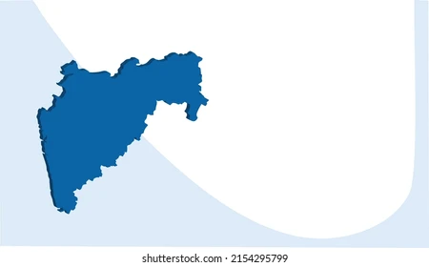
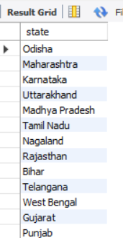
List all unique states where orders have been placed.
SELECT DISTINCT state FROM orders;

Slide 15

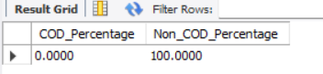
Calculate the percentage of orders that are COD (Cash on Delivery) versus non-COD orders.
SELECT
(SUM(CASE WHEN isCOD = TRUE THEN 1 ELSE 0 END) / COUNT(*)) * 100 AS COD_Percentage,
(SUM(CASE WHEN isCOD = FALSE THEN 1 ELSE 0 END) / COUNT(*)) * 100 AS Non_COD_Percentage FROM orders;

Slide 16
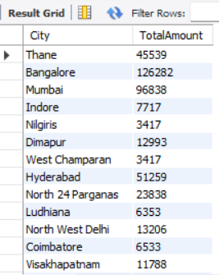

Find the cities where the total Total amount of orders exceeds 1000 from the orders table.
SELECT City, SUM(Total) AS Total Amount FROM `orderscleaned (2)` GROUP BY City
HAVING SUM(Total) > 1000;

Slide 17
Overall Insights
Sales performance by city, state, and IVR type.
Customer behavior, such as payment preferences (COD vs. non-COD) and order sizes.
Geographic distribution of orders, which could inform targeted sales campaigns or logistical decisions.
Trends in order volume and value over time, helping with forecasting and inventory management.
Detailed order data for advanced analysis and reporting.

Slide 18
RECOMMENDATIONS
Focus on cities with high order volumes and total amounts, as identified in the analysis, to optimize inventory management and delivery logistics. Prioritize regions like Maharashtra, where significant customer activity is observed, by tailoring marketing efforts and improving shipping efficiency.
Encourage customers to choose online payment methods over Cash on Delivery (COD) by offering small discounts or rewards. This can reduce dependency on COD, streamline payment processes, and lower operational risks associated with cash handling.
Popular products, such as "Weight-Loss" and "Detox" kits, highlight key customer preferences. Design promotional campaigns, bundle offers, or loyalty programs around these items to attract repeat purchases and new customers.

Slide 19
Conclusion
This project provides a comprehensive analysis of ecommerce order data, offering valuable insights into sales performance, customer behavior, and operational efficiency. By examining total orders and revenue across cities and states, the queries help identify high-performing regions for targeted marketing. Customer payment preferences (COD vs. non-COD) and order sizes are analyzed to enable better segmentation and customized promotions. The project also reveals geographic trends, highlighting areas with high-value customers, and tracks seasonal fluctuations in order volume, aiding in demand forecasting and inventory management.

